Slide 1
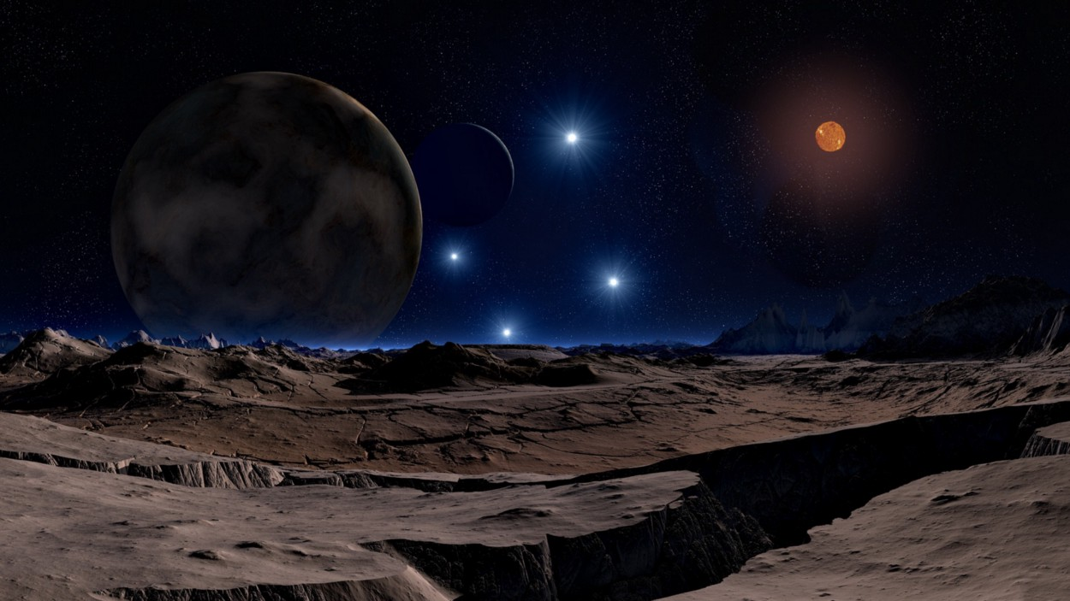
Planet Hunting &
Habitability Detection with Data Science
Prakhar Varshney
Image credit: Lunar Landscape by DasWortewand. CC0 via Pixabay.

Slide 2
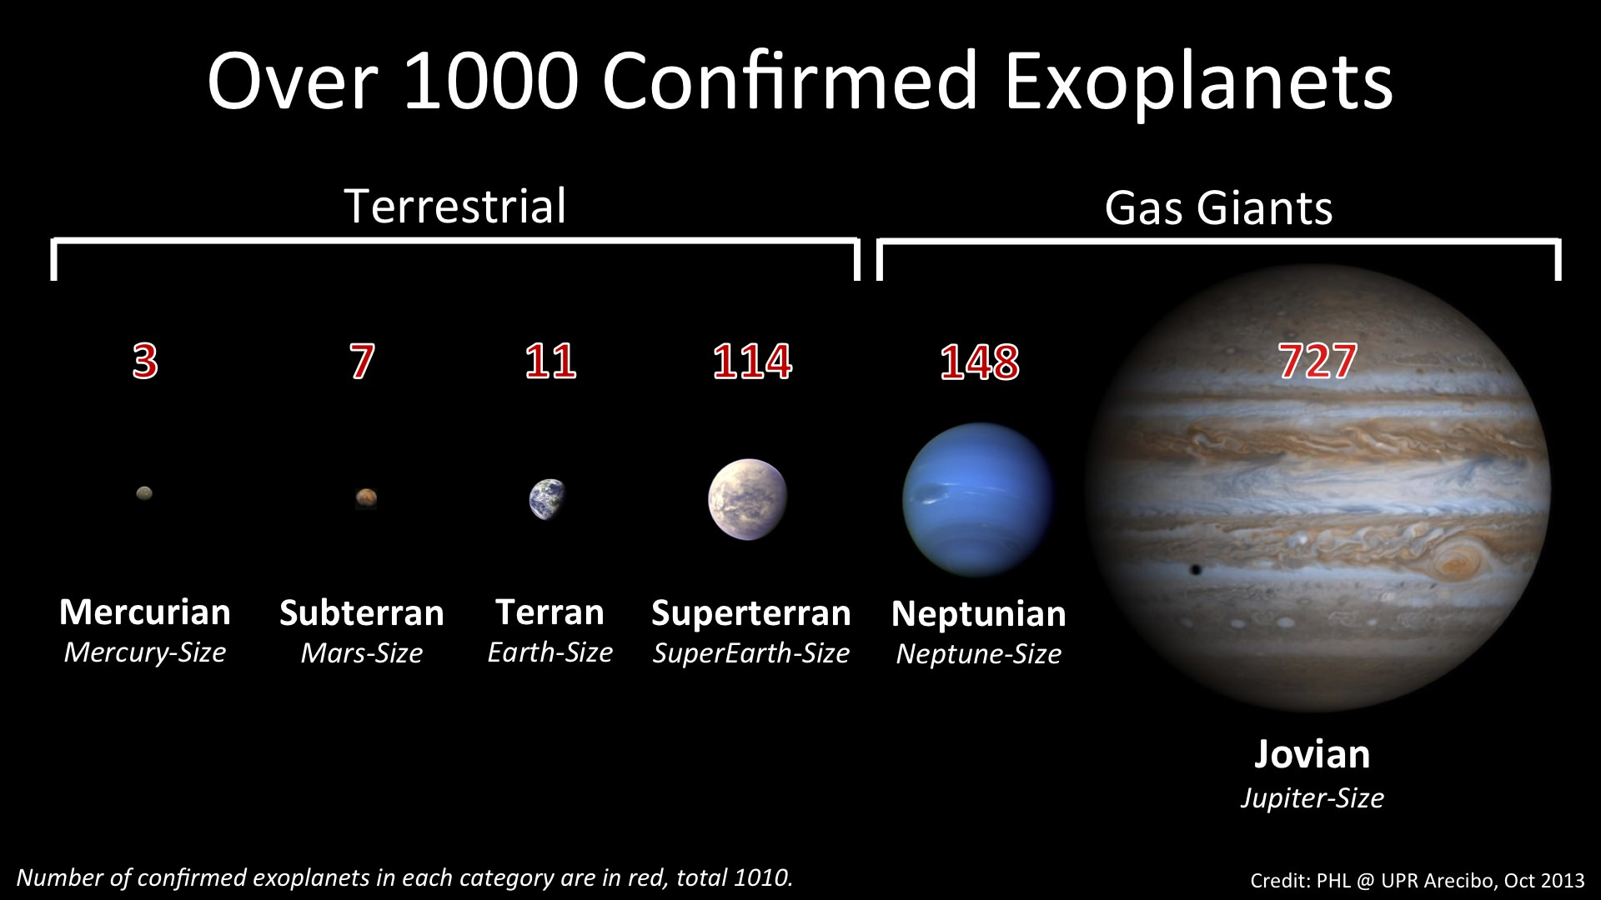
Introduction
Objectives: I had two objectives when I started the project. One is to measure how effective is machine learning to detect exoplanets. And the other one is to predict whether a planet is habitable or not.
Solution: To accomplish these goals, I used three different datasets. I worked on the Kepler data for goal-1 and PHL-Hec data for goal-2. More info is given in the data knowledge sections.

Slide 3
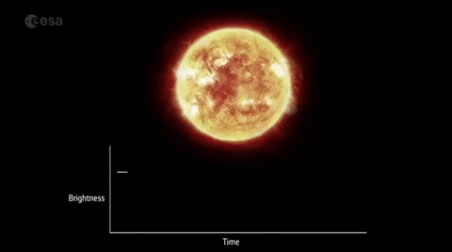
Goal #1: Planet hunting
Exoplanet is a planet that orbits a star outside our solar system.
There are two exoplanet missions: Kepler and Tess.
Kepler observed 530,506 stars and discovered 2,662 exoplanets over its lifetime. The continuing mission, Tess discovered 79 confirmed planet and 2,330 candidates until now.

Slide 4
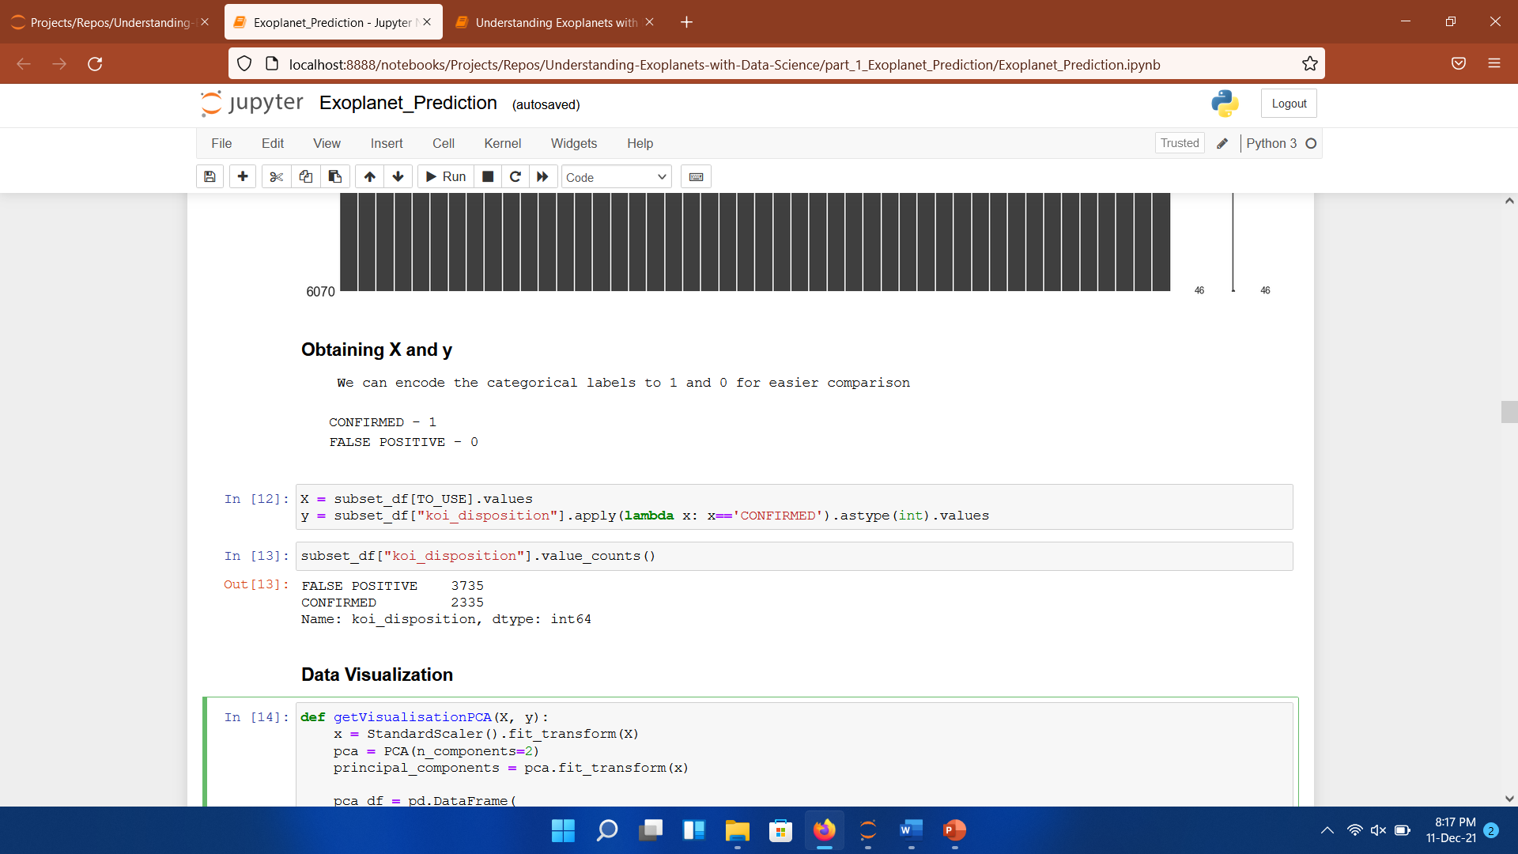
Data & methodology
I extracted the Kepler’s exoplanet data from NASA for my project. Dataset contains 9564 rows with 49 columns.
Th dataset contains a lot of missing values so we have to filter it by.
Removing columns having values less than 40%
Removing rows having NaN in values
After filtering the dataset we have 6070 rows and 46 columns

Slide 5
Data & methodology
Set up & Data Gathering
Gathering data.
Load the data and transform it to pandas DataFrame.
Visualization
Filtering data for missing values.
Visualization of the dataset.

Slide 6
Data & methodology
My dataset was time-series and not really appropriate for the classic machine learning algorithms, so I made my own dataset that has more characteristic features to work on.
Machine Learning
Defining machine learning algorithms.
Evaluation & Optimization.
Feature Enginering

Slide 7
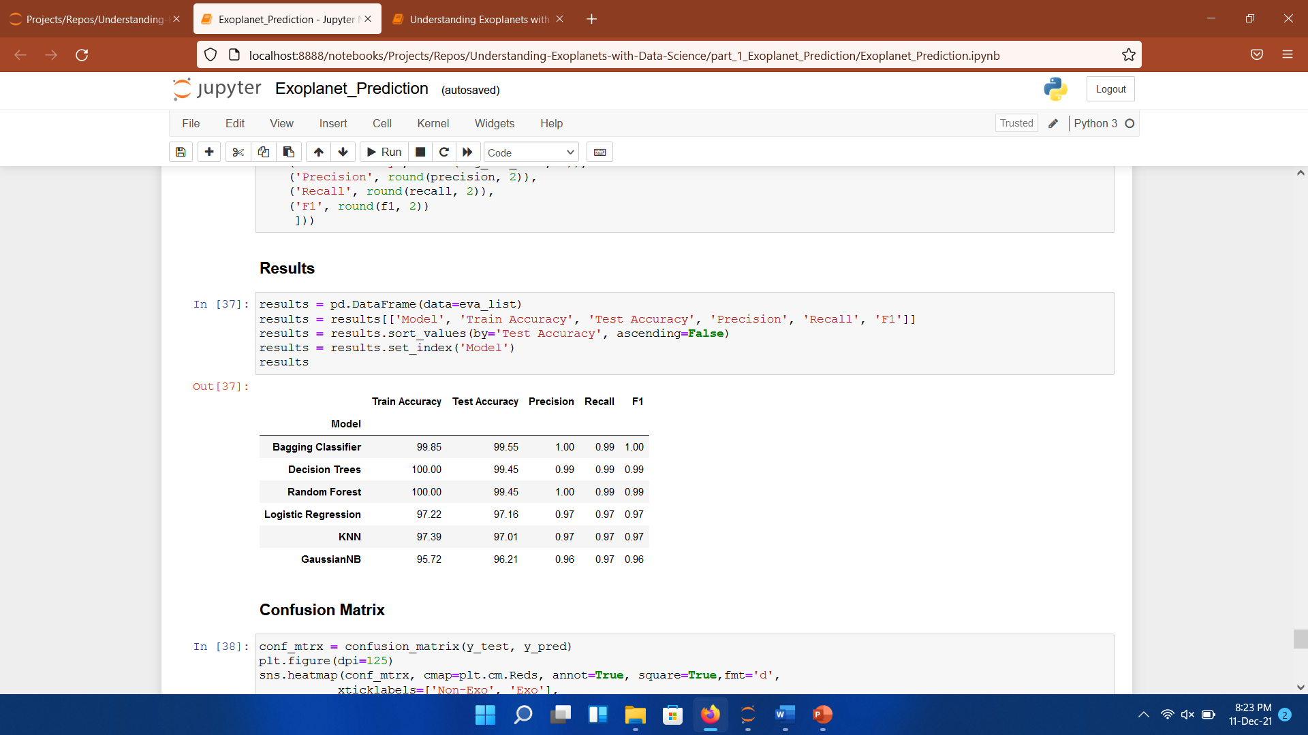
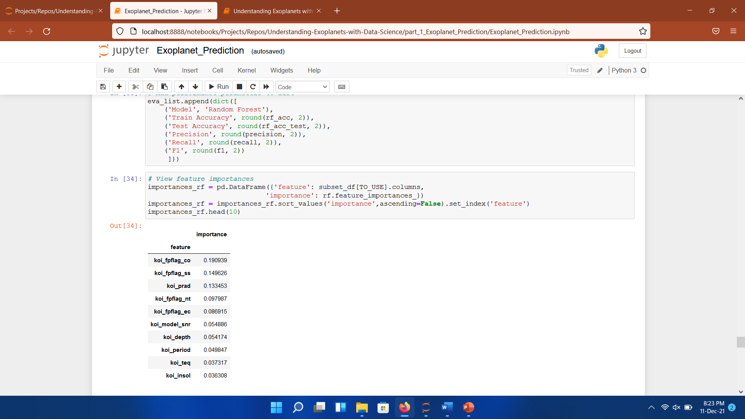
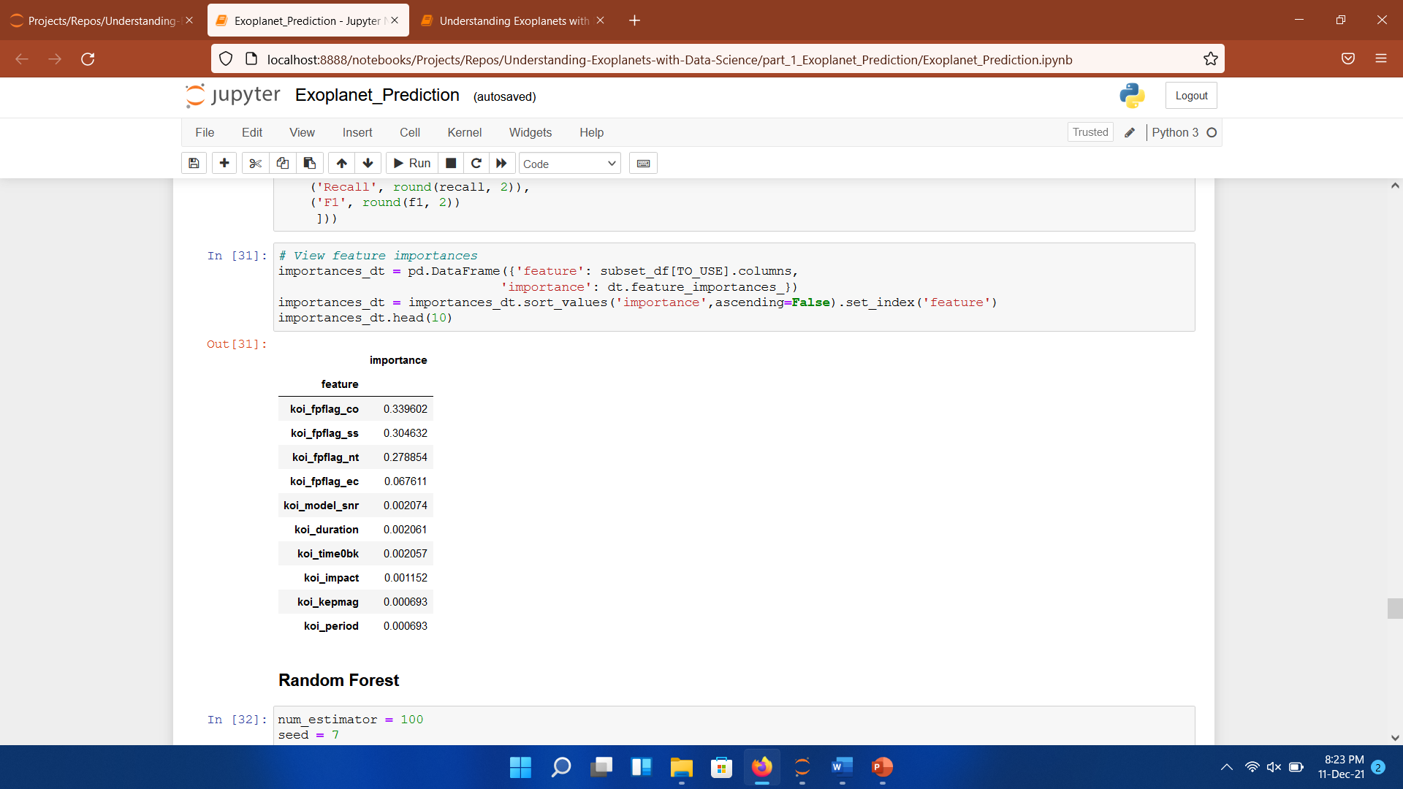
Machine learning
Defined models:
Feature importance tables of random forest and decision tree.

Slide 8
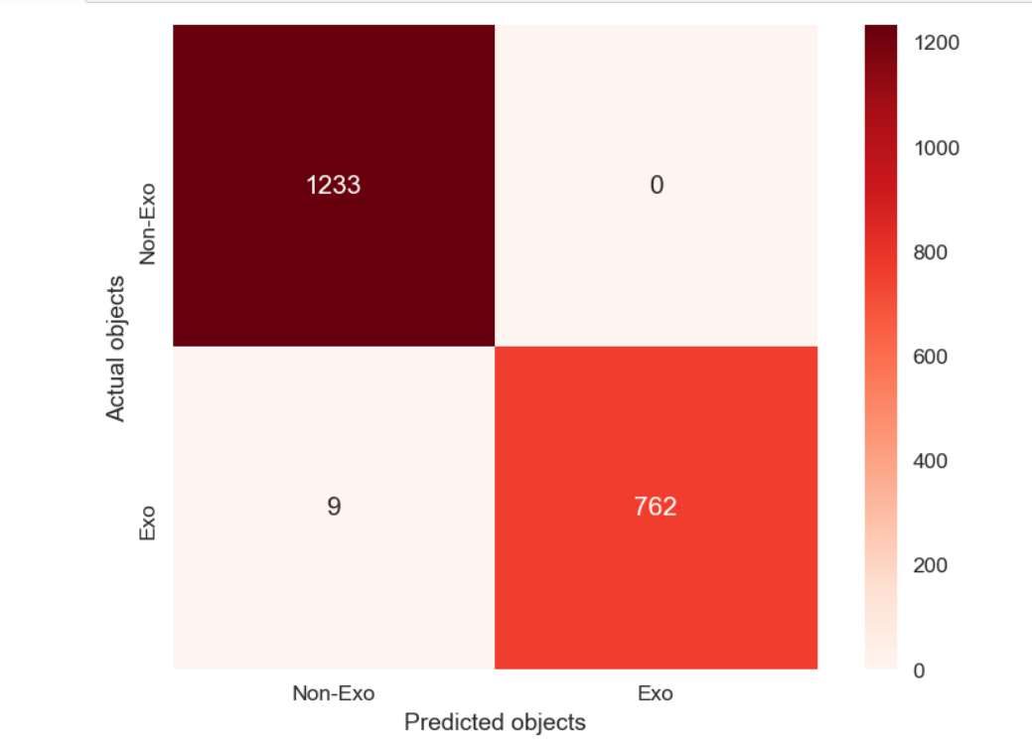
Conclusions
The best result that I got by defined models is approximately 99.55 % for test accuracy.
I could say M.L models are really good at hunting for exoplanets.
The biggest factor in determining exoplanet candidacy is the “koi_fpflag_co” according to feature importance tables.

Slide 9
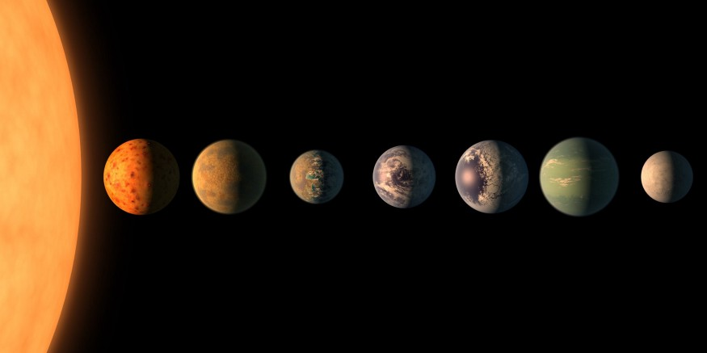
Goal #2: Habitability detectıon
The main objective of exoplanet research is finding habitable planets in different stellar systems.
I extracted the PHL's Exoplanets Catalog to predict habitable planets. It contains observed and modeled parameters for all currently confirmed exoplanets, including those potentially habitable.
“Somewhere, something incredible is waiting
to be known.” Carl Sagan

Slide 10
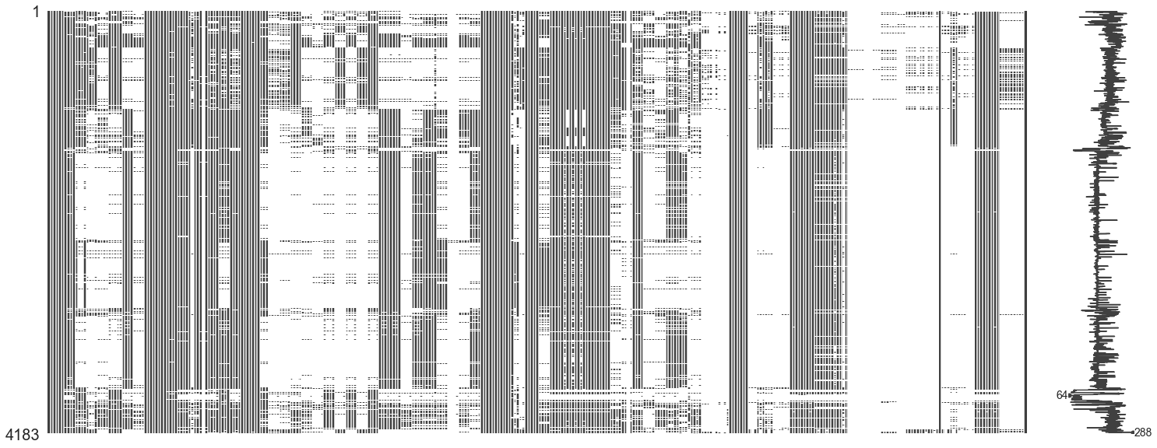
Data knowledge
In my second goal, there are two datasets to handle: Nasa Exoplanet Archive and PHL data which contains habitability situations.
These datasets contain the physical features of planets and stars.
The image that lies on the right is picturing missing values in my main dataset.

Slide 11
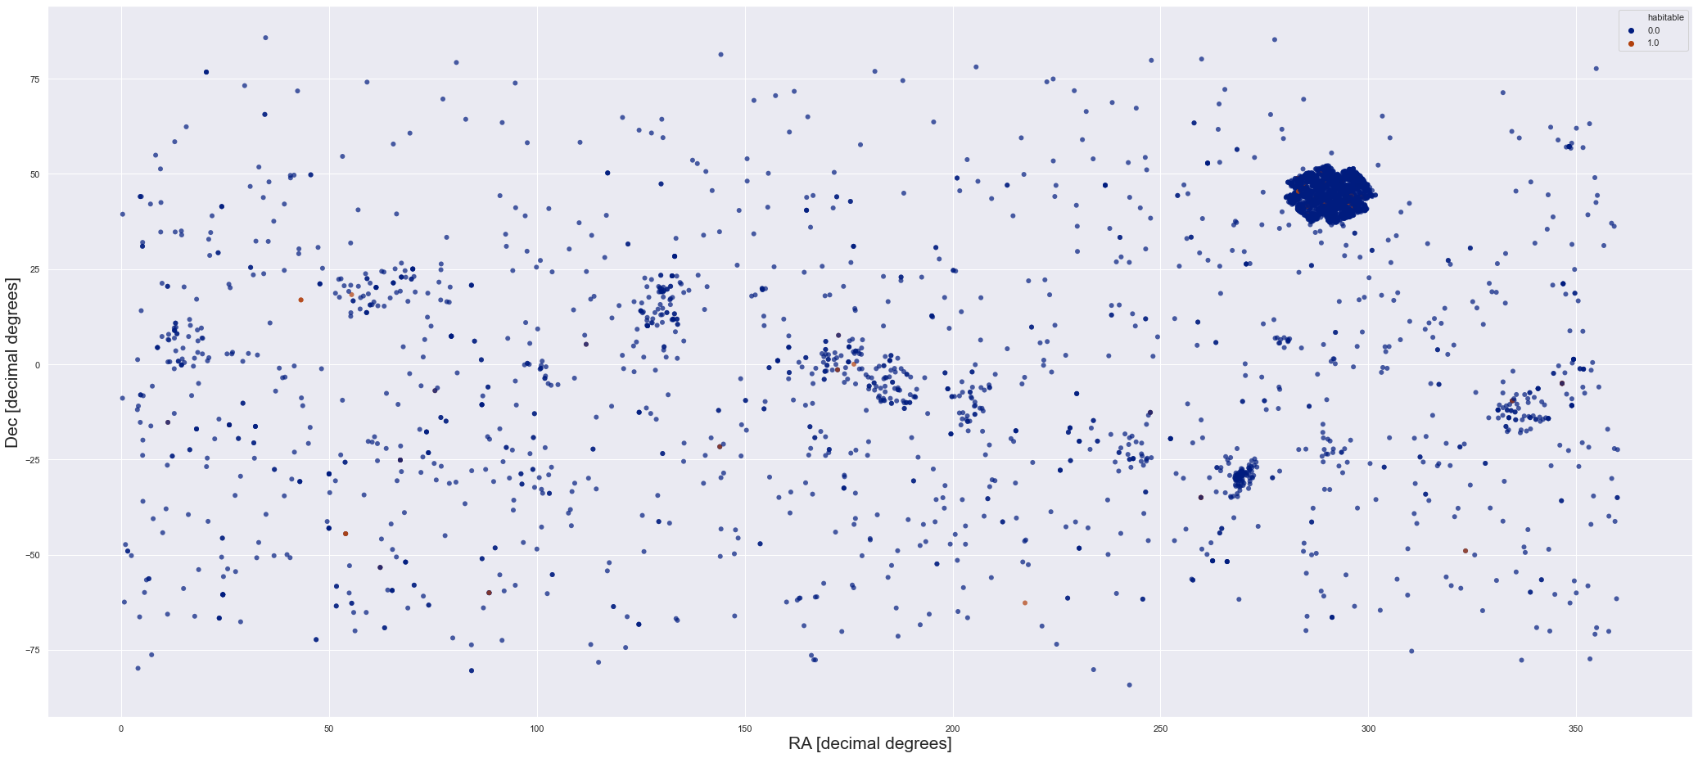
Methodology
The followed methodology in this project is:
Preprocessing and data merging
Handling missing data
EDA/Visualization
Data preparation
SMOTE – Oversampling
Defining machine learning algorithms
Evaluation & Optimization

Slide 12
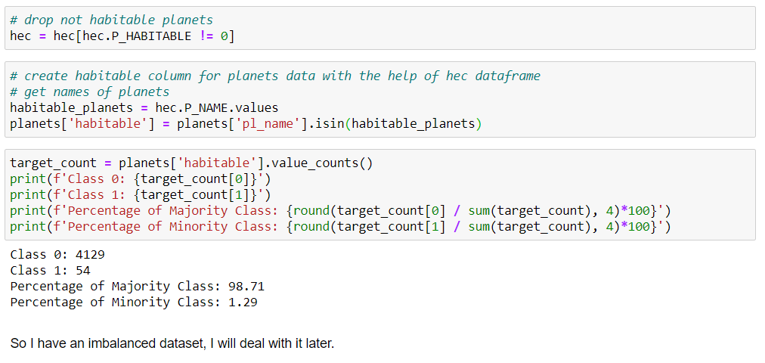
Merging the datasets
As I said before, I have two datasets for the project: NASA and PHL data. The exoplanet archive from NASA is my main dataset because it has more features from the observed planets & stars. I also need PHL data to use its habitability feature.

Slide 13
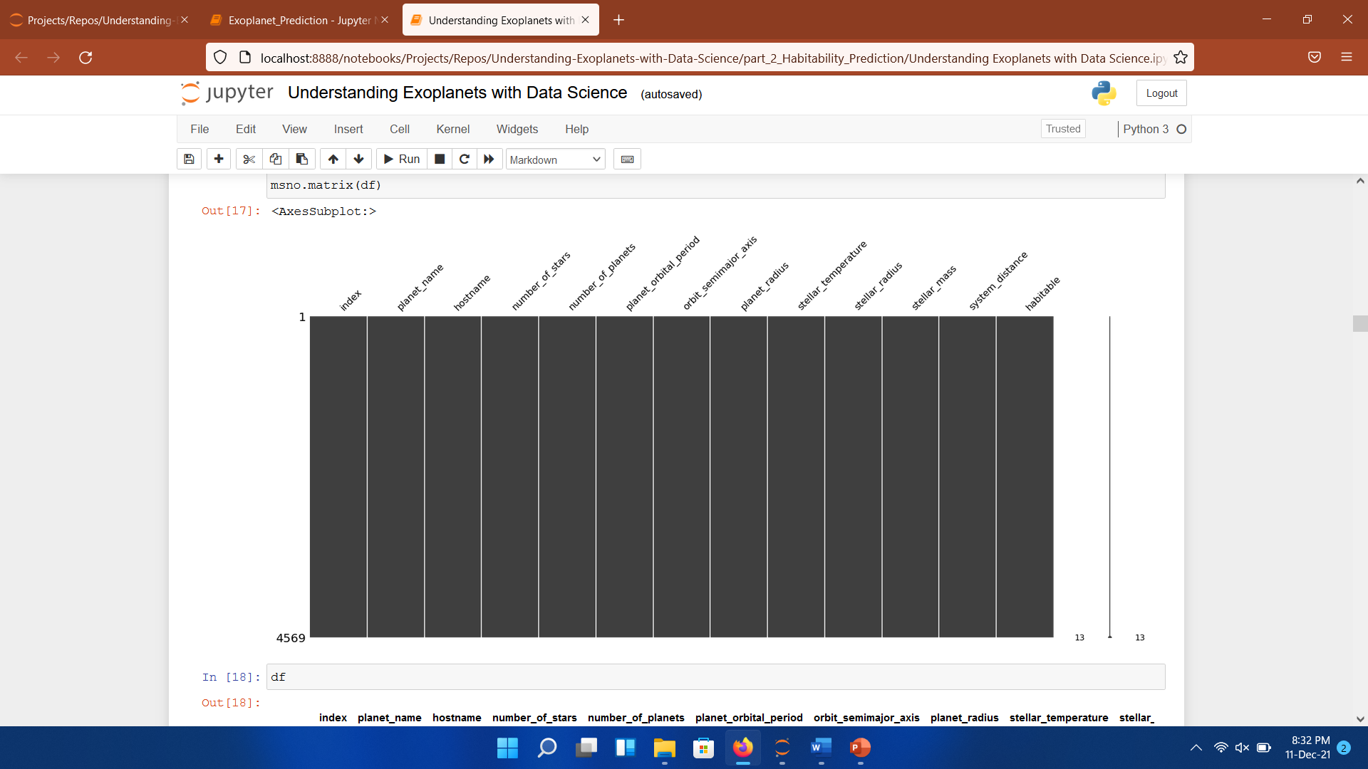
Handling mıssing data
As can be seen in the picture above, I have a lot of missing value in the dataset.
So I followed these steps to solve my problem:
I removed columns with more than 40% missing data.
I removed categorical features with more than 10 unique values.
Iterative imputing on numeric values.
I had 4569 entries when this step was completed.

Slide 14
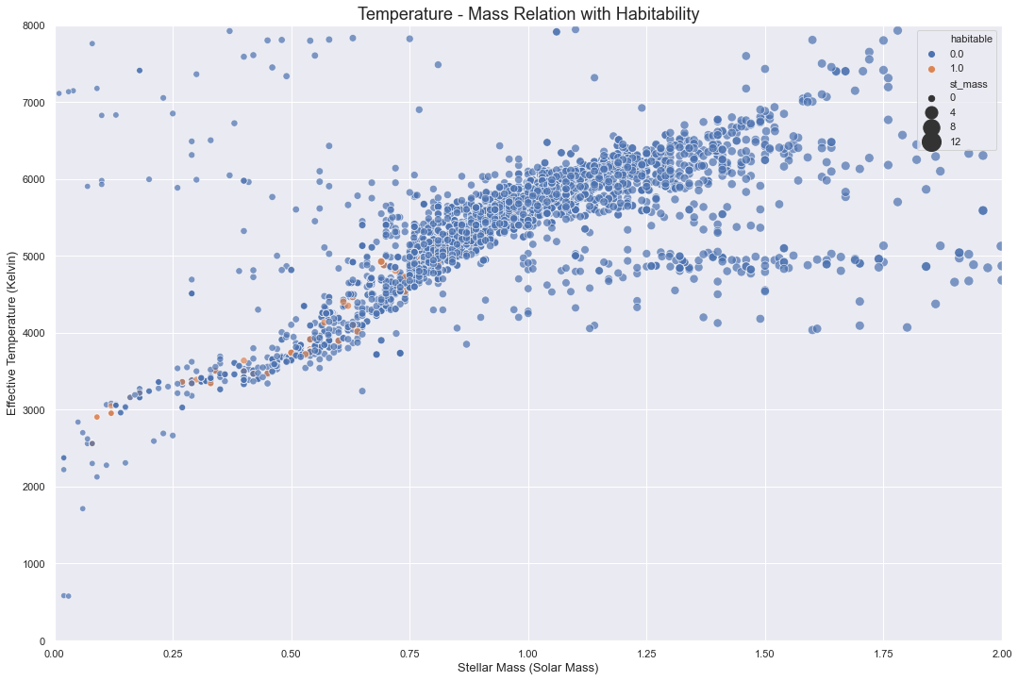

Slide 15
Heading to machine learning
Data Preparation:
Dropping lowly correlated features & selecting highly correlated features for model's dataset.
After some research, I decided to add these features to model's dataset: planet mass, planet's radial velocity amplitude [m/s], equilibrium temperature [K],planet radius [Earth radii], and orbital period [days]. But I have just planet radius and orbital period, there are so many missing data in the other features.
Normalization & logarithmic transformations.
SMOTE – Oversampling

Slide 16
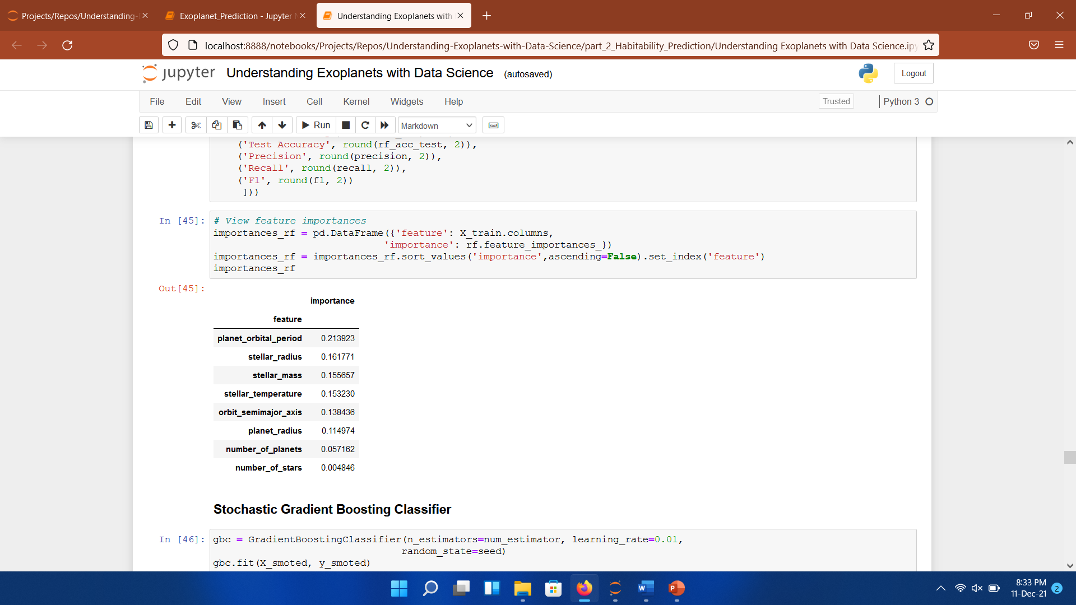

Heading to machine learning
Defined models:
Logistic Regression
KNN
Naive Bayes
Decision Trees
Random Forest
Voting Classifier
AdaBoost
Stochastic Gradient Boosting
XGBoost
Random Forest Decision Tree

Slide 17
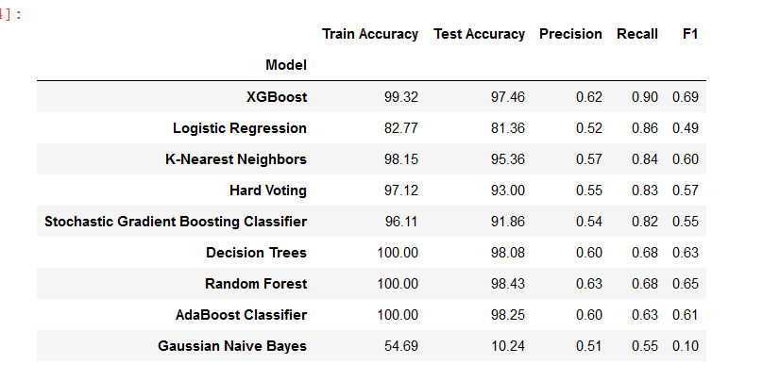
evaluation
Performance of various Machine Learning Classifiers.

Slide 18
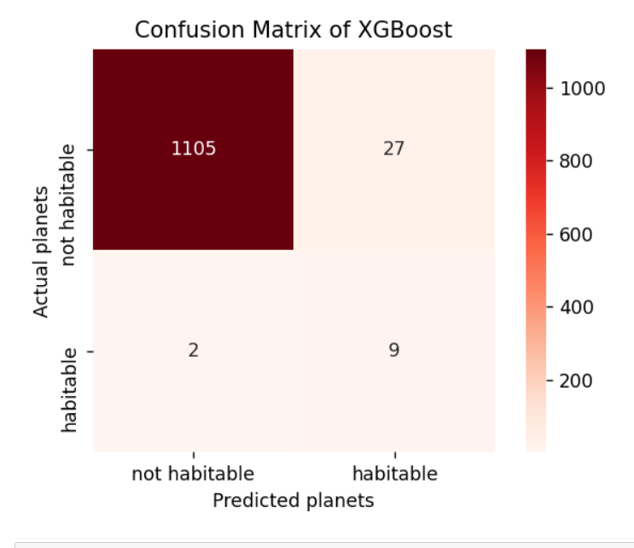
Conclusions
Features like planet Radius, orbital days, stellar surface gravity, and stellar surface temp have a significant impact on the model.
XGBoost is really successful in the task. The model predicted all exoplanets except one.

Slide 19
Further Workings
For goal #1:
To include TESS data in the project.
A visual recognition model could be added.
Research to enrich features.
For goal #2:
Finding most important features for habitability via NLP work on academic papers.
Adding chemical features if it is possible.

Slide 20
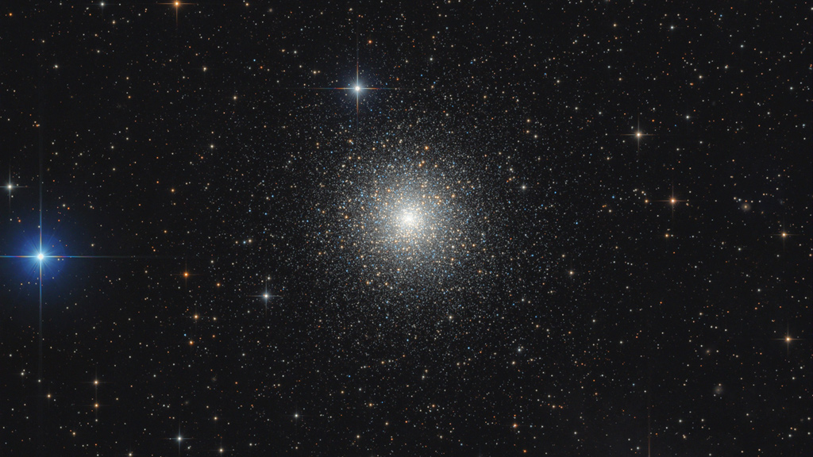
Thank you Prakhar Varshney Boston University

